Slide 1
Code best practices
Edition 1

Slide 2
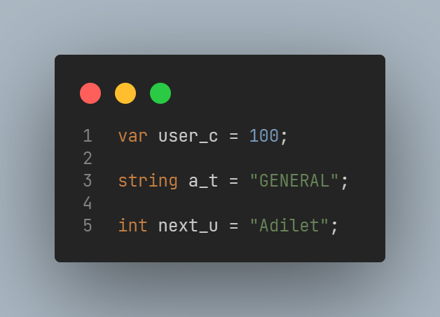
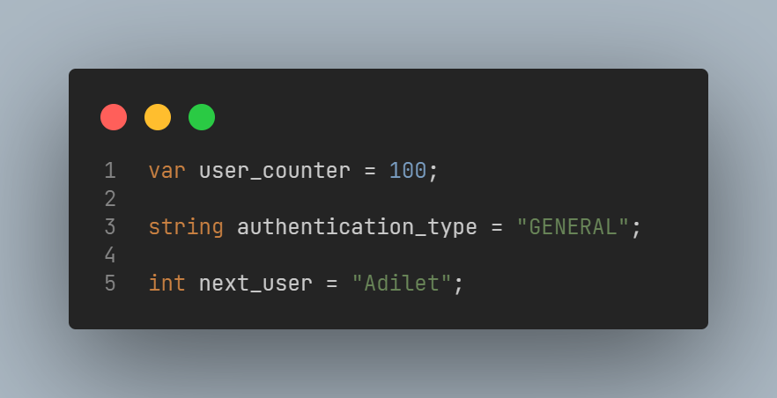
Never use short words
Bad
Good

Slide 3
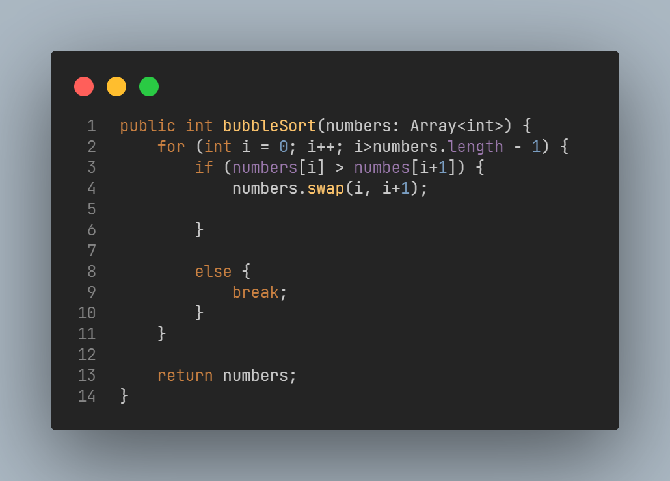
Try to keep code as clean as possible
Short method

Slide 4
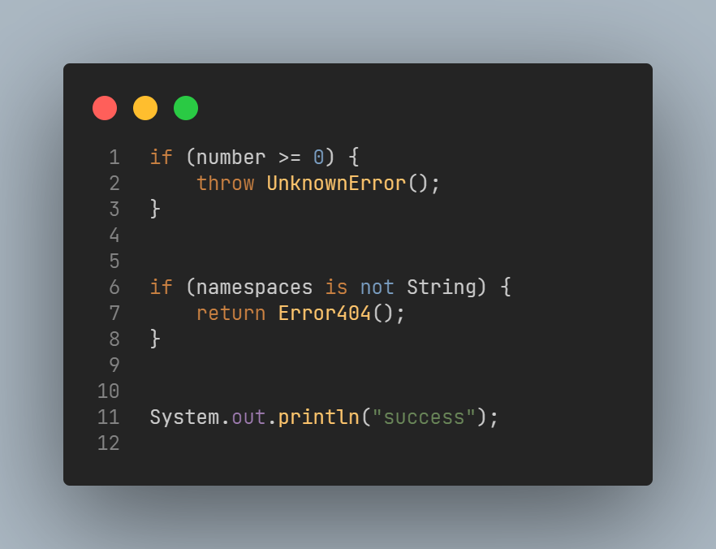
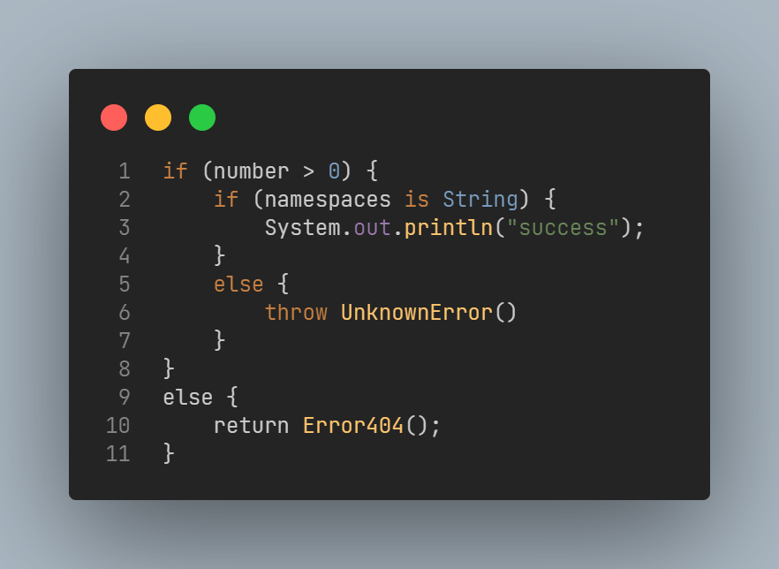
Don’t use nested verification
Bad nesting
Good guards

Slide 5
END

